Slide 1
Part I: Sagehen Forest Project
1950 UC Berkeley Field Station
Tahoe National Forest
2005 Sagehen Experimental Forest
Credit: Jeff Brown, Faerthen Felix, Truckee Ranger District
Sagehenforest.blogspot.com
Notes:
10 miles north of Truckee
9,000 acres
Designated in 2005

Slide 2
SPLATS – Treatment Polygons

Slide 3
Collaboration Begins!

Slide 4
Sagehen Forest Project Collaborators
Conveners
Truckee River Watershed Council
UCB Sagehen Creek Field Station
USFS Tahoe NF, Truckee Ranger District
Environment
Sierra Forest Legacy
The Nature Conservancy
Federal Agencies
US Fish and Wildlife Service
USFS El Dorado NF
USFS PSW Research Station
USFS Regional Office
Industry
Sierra Pacific Industries
Local Government
Sierra County
Other
California Fire Safe Council
Forest Issues Group
Interested Citizens
Nevada County Fire Safe Council
Quincy Library Group
Regional Council of Rural Counties
State Agencies
CAL FIRE
Lahontan Water Board
Sierra Nevada Conservancy
University
Oregon State University
UC Cooperative Extension
University of Nevada Reno

Slide 5
PSW-GTR-220
Fuel Dynamics
Ecological Role of Fire
Climate Change
Sensitive Wildlife Habitat
Forest Heterogeneity & Resilience

Slide 6
18 Months Later…

Slide 7
Agreed! Sagehen Forest Project Goals
Enhance American Marten Habitat
Restore Stand Level Ecology
Reduce Fuel
Orient Goals According to Where they Occur on the Landscape

Slide 8
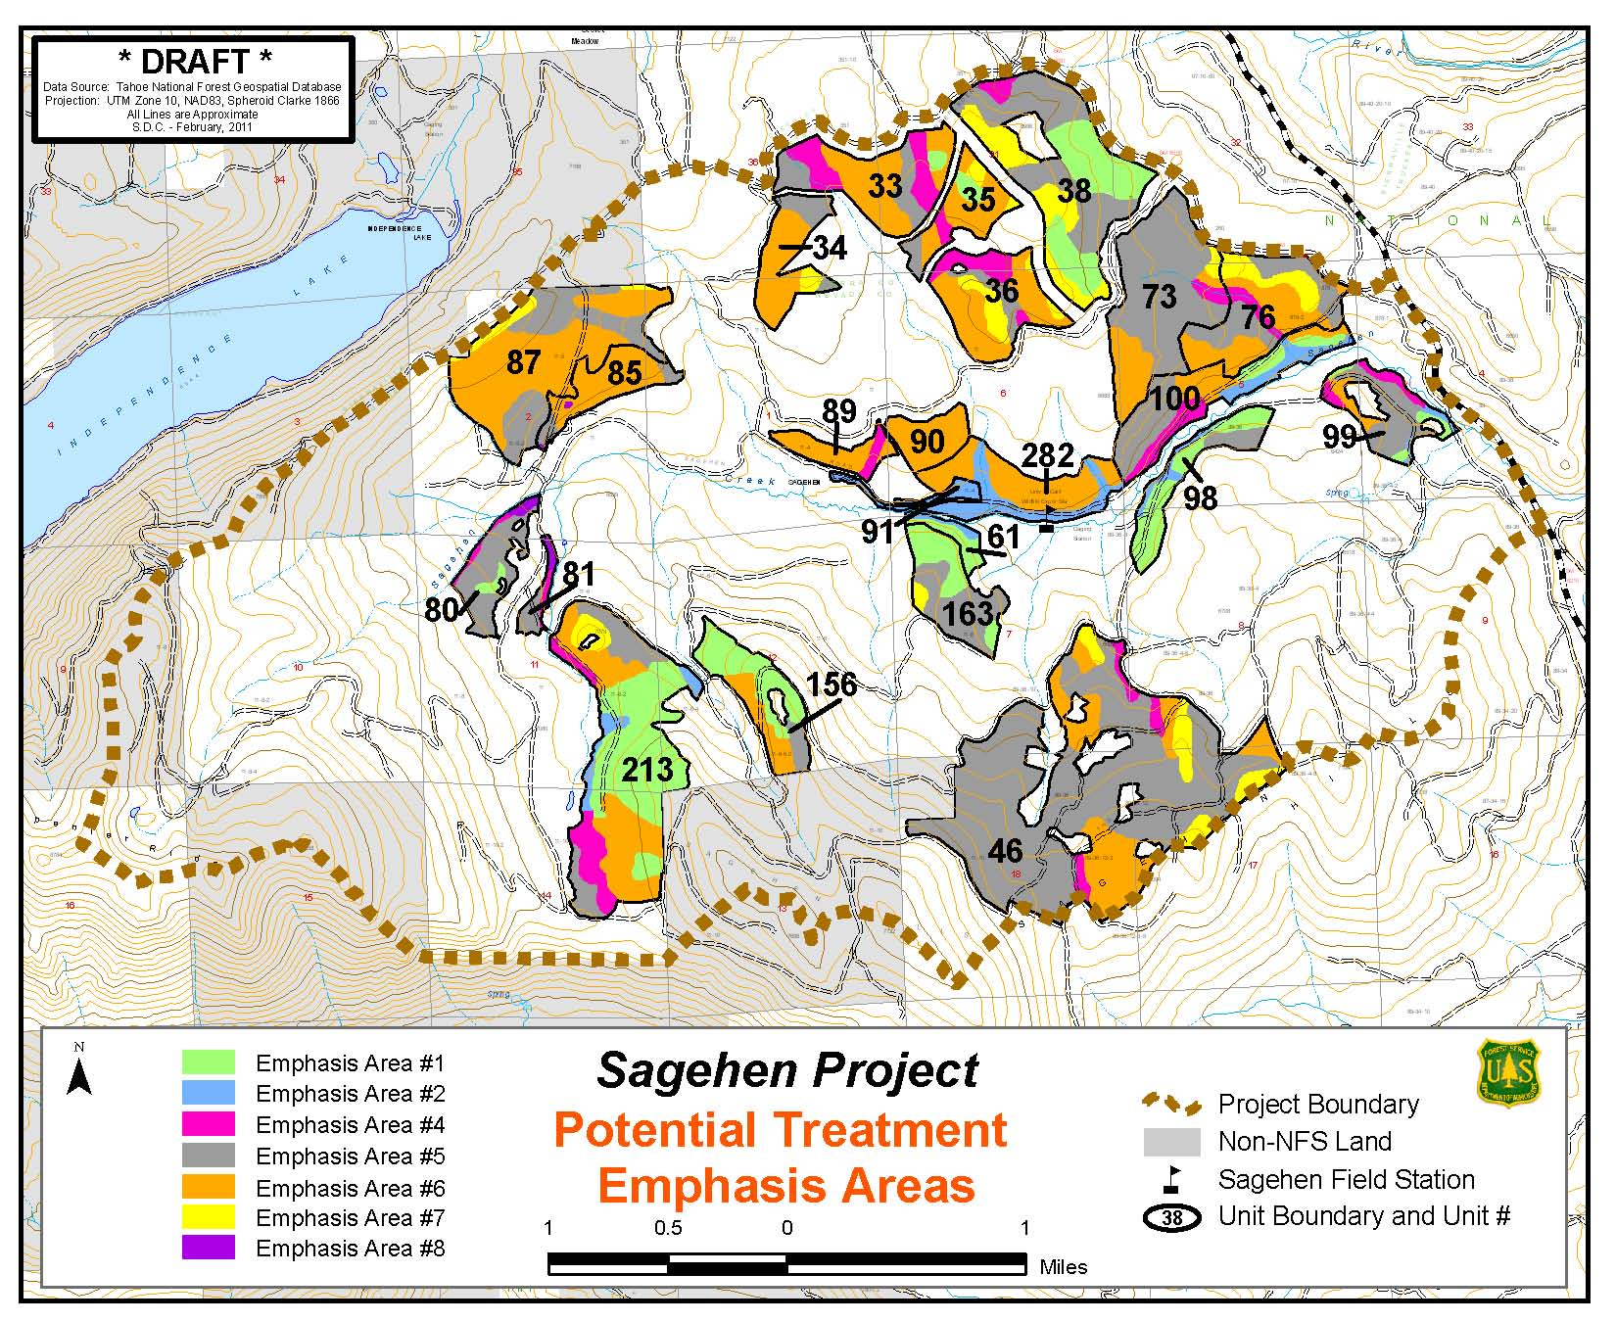
Tahoe National Forest, Truckee Ranger District
PSW Sagehen Experimental Forest
UC Berkeley Sagehen Field Station
Sagehen Project

Slide 9
March 2013
Total Project Area: 9,500 acres
Treated Area: 2,600 acres
Distributed in 8 “SPLATS”
No Litigation
Support Letters From Sierra Forest Legacy and SPI

Slide 10
Waiting For Bids…

Slide 11
Still Waiting…

Slide 12
Still Waiting…

Slide 13
Turned Out Getting Environmentalists and Loggers to Agree Was the Easy Part!

Slide 14
Trees Don’t Just Walk Out Of The Woods

Slide 15
The Takeaway…
There aren’t enough biomass facilities and lumber mills in California to process the significant amounts of sawlogs and chips that need to come out to achieve forest resiliency and ecological balance.
Sagehen Blog

Slide 16
2015: Governor Brown’s Proclamation

Slide 17
UC Berkeley Takes Action

Slide 18
2016 UC Berkeley: Treated 600 acres No Merchantable Timber
Half Masticated
Half Hand-Thinned
Broadcast Burned This Winter

Slide 19
Mastication Removed Trees 12” Or Smaller
But 2,000 Acres Managed By Forest Service,
With Merchantable Timber,
Still Sitting There

Slide 20
Key Partnership: Center For The Study of The Force Majeure

Slide 21
Part II: “Saving The West”
Eco-artists Communicate Vision for 11 Western States
Sagehen Creek Field Station
National Forest Foundation
Truckee Community Foundation

Slide 22
How Can We Rebuild the Forest Industry Cluster to Increase Demand For CA-Grown Wood?

Slide 23
Global Economy vs. Sustainability

Slide 24
US Imports More Wood Than It Exports

Slide 25
Canada Is Very Competitive…

Slide 26
CA, OR & WA Consume More Wood Products Than We Produce

Slide 27
Industry Clusters: Business Analogy to Ecosystems
Groups of related firms in a geographic area that share common markets, technologies, worker skills, and are linked by buyer-seller relationships.
Clusters include both high and low-value added employment.

Slide 28
Forest Clusters: Affected By Macro Trends

Slide 29
Reframe Using Values of Political Elites: e.g. Climate Change
Biomass puts to use energy from wood that will burn anyway
Biomass can offset fossil fuels from belowground
Bioenergy reduces black carbon from wildfires

Slide 30
Tall Wooden Buildings Lock Up Carbon

Slide 31
Collaborate With Expertise We Don’t Have
Business
Finance
Venture Capital
Philanthropy
University R&D

Slide 32
New Forest Cluster Based On Sustainable BioEconomy
Build Competitive New Industry Cluster
Invest in Most Efficient Equipment & Processes
Collaborate With Innovative Entrepreneurs
Develop Flexible Production and Distribution Systems
Take Advantage of New Business Models and New Materials
Ally With Other Industries, e.g. Chemicals and Energy

Slide 33
Tahoe-Sierra Resilient Forest Initiatives

Slide 34
Summary: Saving The West
Building Organizational Capacity
Big Tent Approach: Prescriptions Can Vary With Place
Focus on Cause of Wildfires and Tree Mortality: Too Many Trees
Work at Scale Needed to Transform Fire Behavior
Potential to Save $Billions in Fighting Fires
Need to Re-Build Forest Industry Sector and Demand to Create Sustainable BioEconomy

