Slide 1
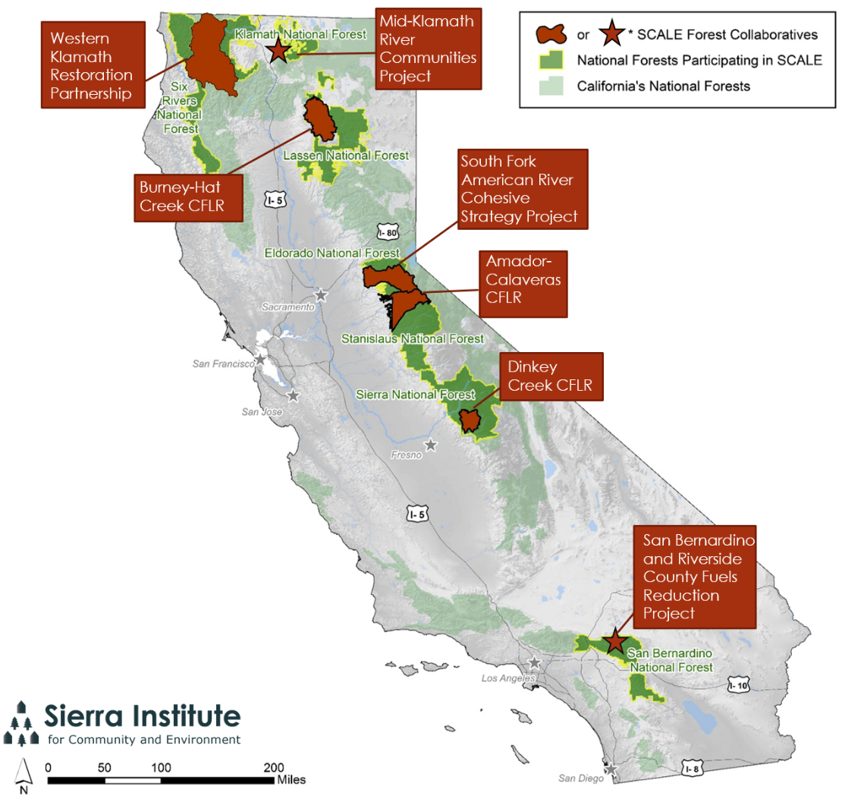
SCALE Sierra-to-California All-Lands Enhancement

Slide 2
Key Issues Identified via SCALE
Budget Transparency
Administration and Facilitation Dollars
Socioeconomic Monitoring
Regular budget updates
Admin and Facil support
National Examination of trends and challenges
Photo Credit: NASA Goddard Space Flight Center

Slide 3
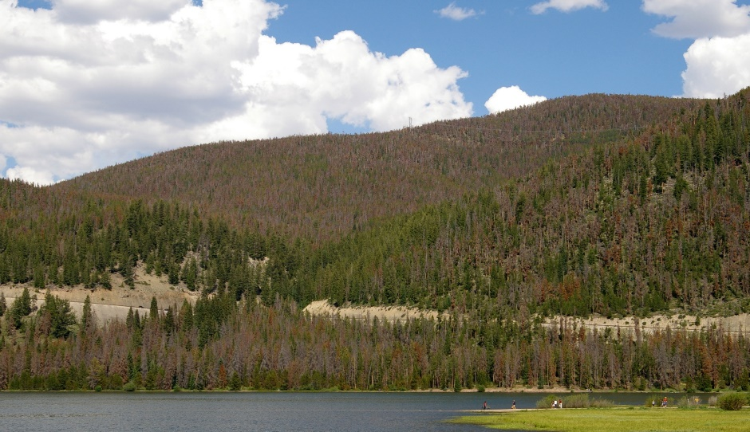
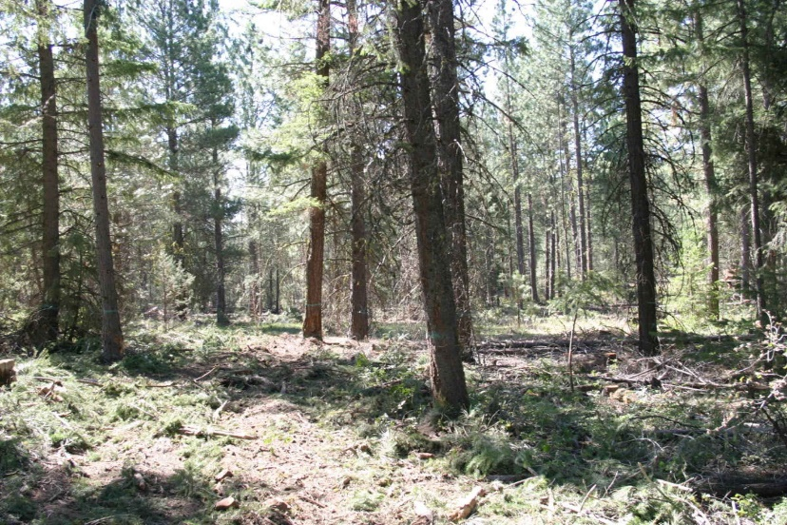
Key Issues Identified via SCALE, continued
Local Contracting
Defining Local
All-Lands/ Landscape scale
Identifying and Sharing Lessons Learned
Recent research (today’s meeting)
All-Lands: 2016/2017
Lessons Learned: 2016/2017
By Hustvedt (Own work) [CC BY-SA 3.0 (http://creativecommons.org/licenses/by-sa/3.0) or GFDL (http://www.gnu.org/copyleft/fdl.html)], via Wikimedia Commons
By Swanson Scott, U.S. Fish and Wildlife Service [Public domain], via Wikimedia Commons

Slide 4
Defining Local & Local Contracting Two SCALE Research Initiatives

Slide 5
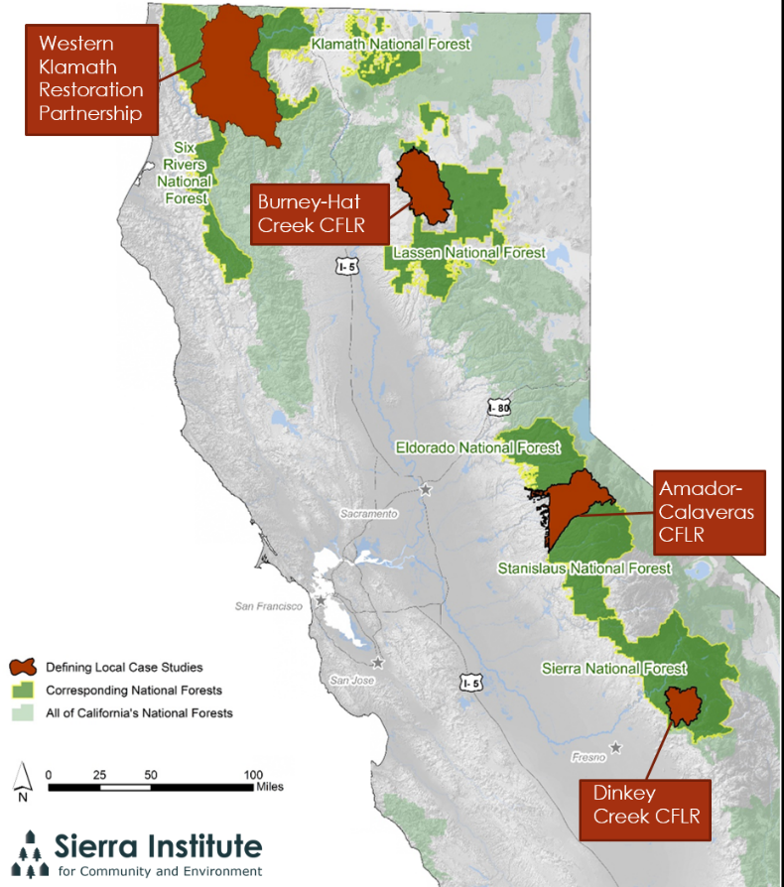
Project Overview
Project Origins
Research Scope
Purpose
Notes:
Case Studies 1-3: BHC= Lassen, ACCG= El Dorado/ Stanislaus, Dinkey= Sierra)
Case Studies 4 & 5: All lands projects within CA that are part of the Cohesive Fire Strategy (Governor’s selection of priority area), funded for all lands work in 2014
Case Study 5: Six Rivers National Forest (Klamath)
Southfork American River Watershed Cohesive Strategic Landscape Project
Eldorado National Forest (highway 50 corridor)
A combination of 2 initiatives, both funded in 2014
USDA Farm Bill, 91,000 acres, all USFS land, emphasis on insects and disease
Cohesive Fire Strategy (Governor’s selection of priority area) expanded into a 409,895 acre (250,000 acres of USFS) landscape that does include private lands, emphasis on wild land fire risk reduction
Received first ear-marked funding in 2013
2 part strategy
A 2-year incorporation of their 5 year thinning plan on former timber plantations within the 90,000 acres. This does involve working on private lands and they are partnering with SPI to create fuel breaks and thin. Currently in the field work/ pre public scoping phase of the project. A timeline will likely be available in late February.
In contract with the Institute for Environmental Conflict Resolution to develop a stakeholder collaborative group. The agreement began in August and they have had several planning meetings; hoping to have the collaborative established by May or June

Slide 6
USFS Pacific Southwest Region’s Intent

Slide 7
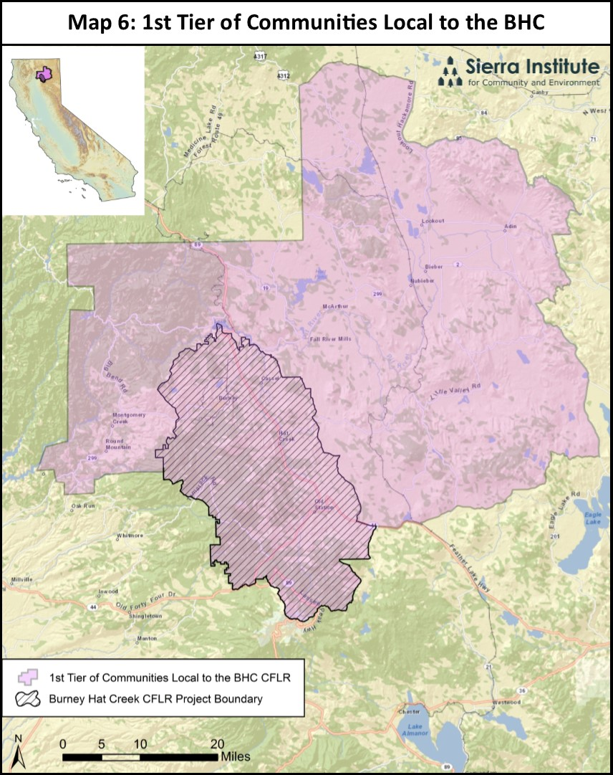
Notes:
Cultural ties to the landscape
Economic patterns
Biophysical boundaries
Exisiting socioeconomic boundaries

Slide 8
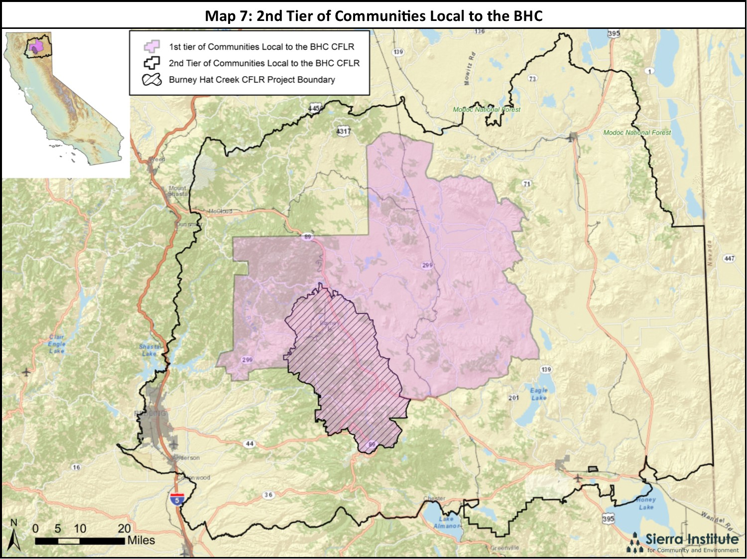

Slide 9
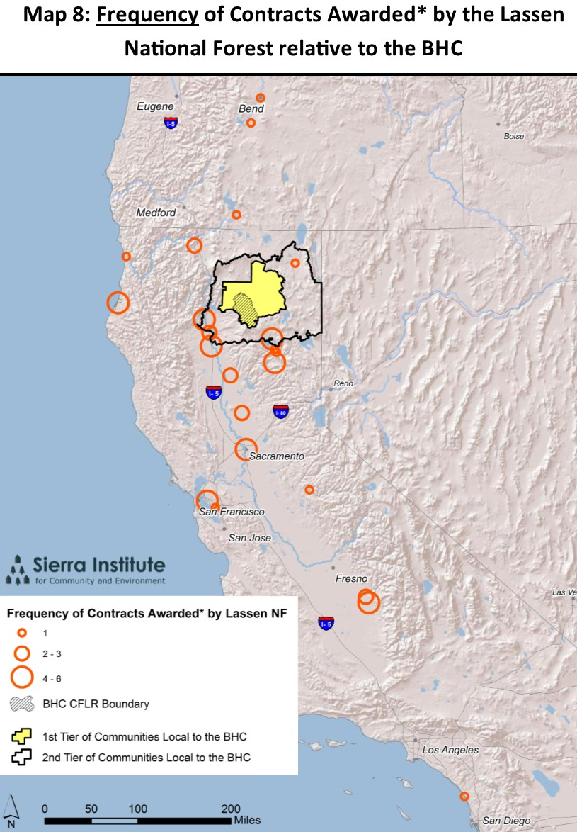
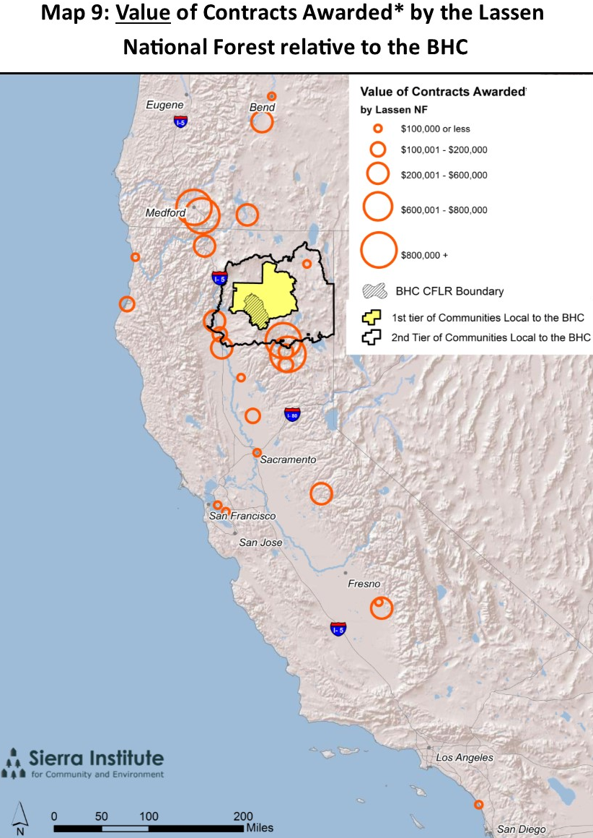

Slide 10
Local Benefit Evaluation Process
Variable | Threshold | Points Relative to 1st Tier | Points Relative to 2nd Tier | Points Relative to 3rd Tier
Location | Headquarters are within | 3 | 2 | 1
Employees, including subcontractors | 50%+ | 3 | 2 | 1
Other Socioeconomic Contributions, including local supplies | Narrative | 5 | 3 | 2
Notes:
(Local supplies, biobased-fuels, employment training, local philanthropy)_

Slide 11
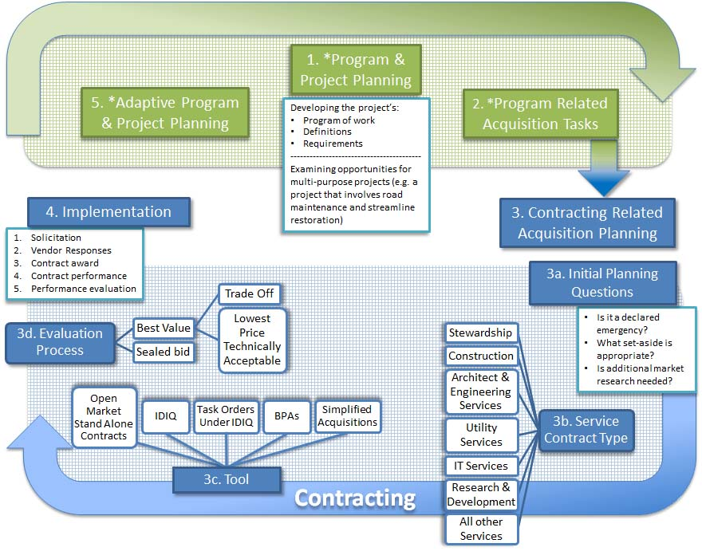
Collaborative Input
Notes:
The above diagram illustrates the pathway to a service contract acquisition. Note that the path is cyclic and contains program management steps (highlighted in green) as well as contracting components (highlighted in blue). Collaborative input is most effective during the program management portions of the flow path. Also note that while Stewardship Contracts are required to use the tradeoff process nested within Best Value Evaluation, other contracts may use this process as well.

Slide 12
Types of Federal Acquisitions
Acquisitions
Partnership Agreements
Procurement Instruments

Slide 13
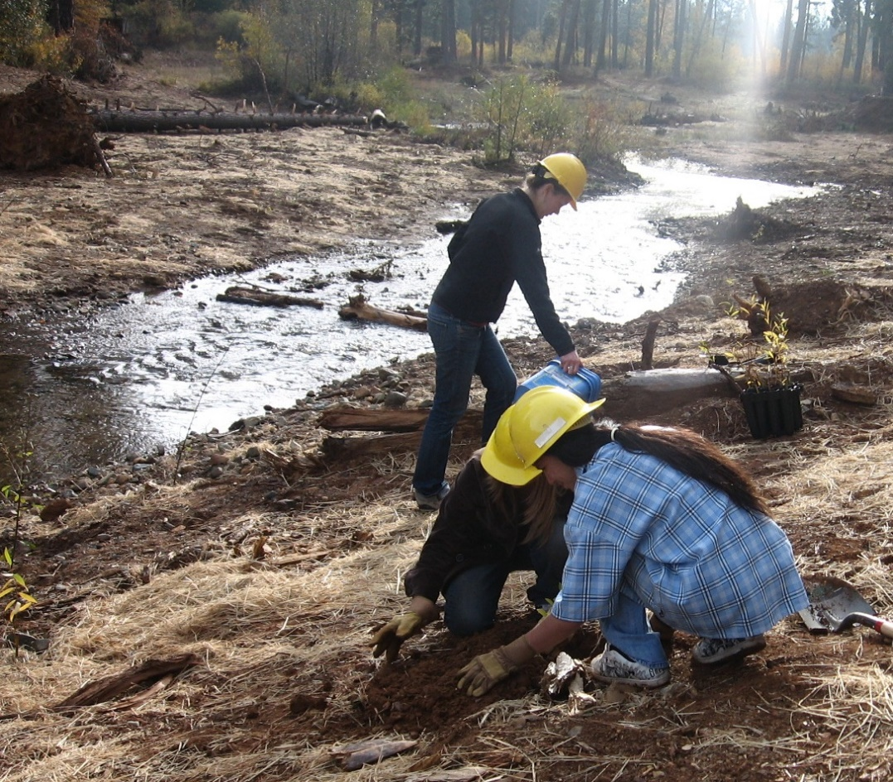
[Program-Relating Components]
1. Program & Project Planning →
Developing the project’s:
Program of Work
Definitions
Requirements
2. Program Related Acquisition Tasks
3. The “Hand-off” to Contracting Staff

Slide 14
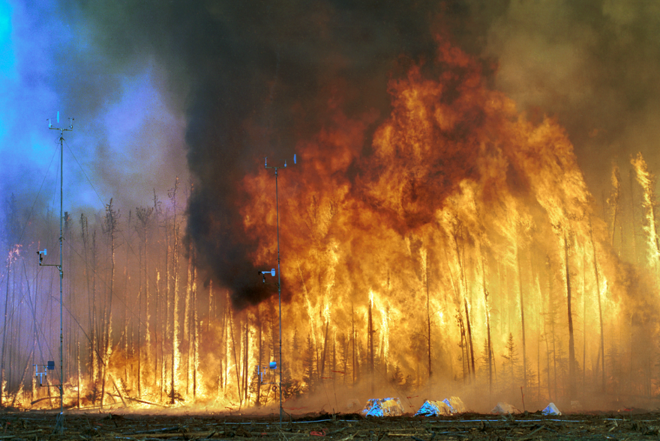
Initial Contracting Questions
Is it a declared emergency?
What set-aside is appropriate?
Is additional market research needed?
By (Photograph used by permission of the USDA Forest Service.) - Bunk S: World on Fire. PLoS Biol 2/2/2004: e54. doi:10.1371/journal.pbio.0020054.g001, CC BY 2.5, https://commons.wikimedia.org/w/index.php?curid=1370864

Slide 15
Service Contract Type
Stewardship
Construction
Architect and Engineer
Utility Services
IT Services
R & D
All other Services

Slide 16
Tool
Simplified Acquisitions
Open Market Stand Alone Contracts
Indefinite Delivery, Indefinite Quantity
Task Orders Under IDIQ
Blanket Purchase Agreements (BPAs)

Slide 17
Evaluation Process
Best Value
Lowest Price Technically Acceptable (LPTA)
Trade-Off

Slide 18
Implementation
Solicitation
Vendor Responses
Contract Award
Contract Performance
Performance Evaluation
→ Adaptive Program and Project Planning

Slide 19
Collaborative Input
Notes:
The above diagram illustrates the pathway to a service contract acquisition. Note that the path is cyclic and contains program management steps (highlighted in green) as well as contracting components (highlighted in blue). Collaborative input is most effective during the program management portions of the flow path. Also note that while Stewardship Contracts are required to use the tradeoff process nested within Best Value Evaluation, other contracts may use this process as well.

Slide 20
PATHWAY TO SERVICE CONTRACTS Opportunities for Collaborative Input in Yellow
Program and Project Planning
Program Management Related Acquisition Planning → Contracting-Related Acquisition Planning
Acquisitions Planning
Choosing a: Contract type, Tool, and Evaluation Process
Monitoring and Adaptive Planning

Slide 21
Defining Local and Local Contracting
Jonathan: jkusel@sierrainstitute.us | 530.284.1022
Allison: ajolley@sierrainstitute.us | 530.284.1022
Sheri: selliott@fs.fed.us
Marilyn: mladd@fs.fed.us
Pierce: pierceetucker@fs.fed.us
Notes:
Q & A
Pierce Roll Out
Discussion on pilot

